Slide 1



PREDICTION OF GHG EMISSIONS USING ENSEMBLE METHODS FOR SUPPLY CHAIN EMISSION FACTOR ESTIMATION
SNEHA SUCHARITHA K
SHAM S
SETHURAMAN S
STUDENTS FROM
RAJALAKSHMI INSTITUTE OF TECHNOLOGY
Guided by:
Monika Ma'am,
Assistant Professor,
Dept. of Al & DS, RIT

Slide 2
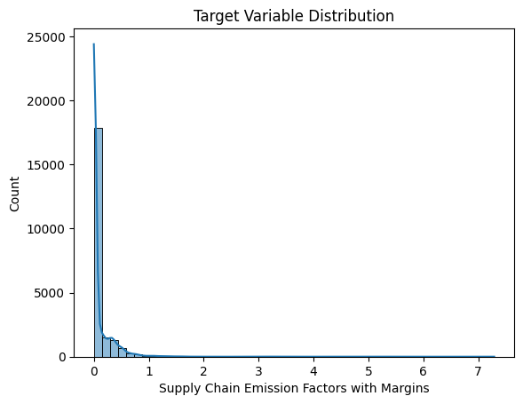
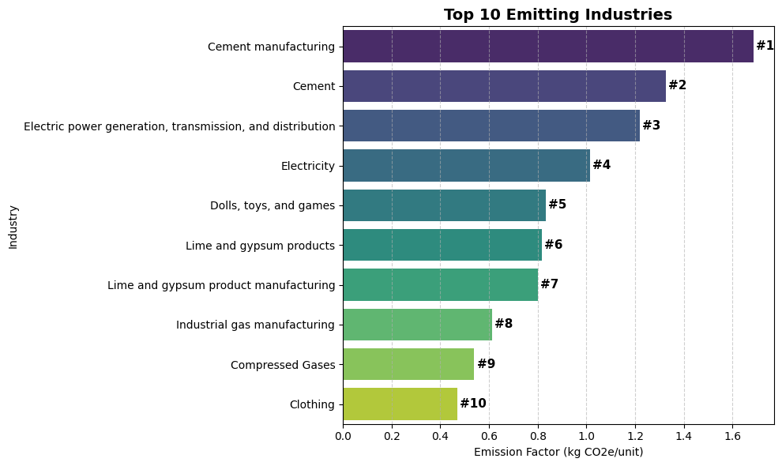
BACKGROUND – CLIMATE CHALLENGE
Climate change has made greenhouse gas monitoring a global priority.
Supply chain emissions (Scope 3) are the largest share of corporate footprints.

Slide 3
Background – Research Gap
Existing approaches: mainly statistical regressions, limited transparency, low interpretability.
Problem: current models ignore uncertainty and data quality, leading to less reliable predictions.
Gap: Need for a framework that combines accuracy, transparency, and usability.
These emissions are difficult to measure due to:
Decentralized and complex supply chains
Inconsistent reporting standards
Poor data availability and quality

Slide 4
BACKGROUND – OBJECTIVE OF STUDY
To develop a machine learning framework that predicts greenhouse gas emission factors for supply chains.
To integrate data quality indicators (reliability, temporal, geographic, technological) into the model.
To improve both prediction accuracy and interpretability compared to traditional approaches.
To create an interactive tool that makes results practical and accessible for stakeholders.

Slide 5
METHODLOGY
Source: United States Environmental Protection Agency (2010–2016).
Covers multiple industries and commodities classified by NAICS codes.
Target variable: Greenhouse gas emission factor (kg CO₂-equivalent per economic unit).
Features included:
Reliability scores(92.3%).
Temporal, geographic, and technological correlations.
Two models were implemented: Linear Regression, which provides a transparent baseline, and Random Forest Regression, which captures complex non-linear interactions.
Cross-validation and residual diagnostics were used to ensure generalizability and robustness of the models.

Slide 6
RESULT
Random Forest Regression achieved higher accuracy (R²) and lower error (RMSE, MAE) compared to Linear Regression.
Feature importance analysis showed that data quality metrics significantly improved predictions.
Developed an interactive Streamlit tool for real-time predictions and visualizations.

Slide 7
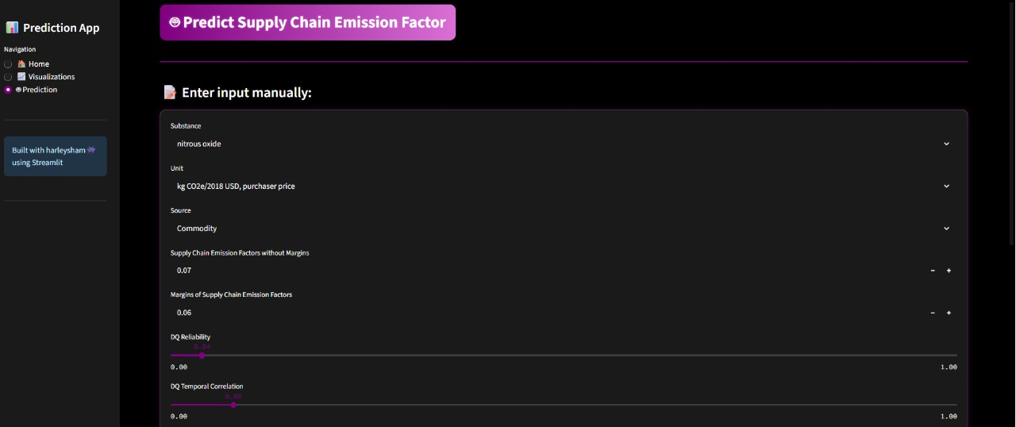
RESULT

Slide 8
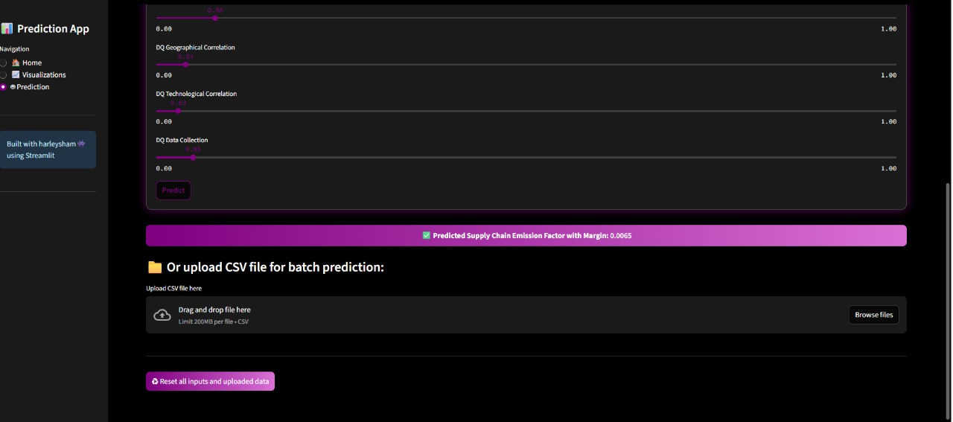
RESULT

Slide 9
DISCUSSION
The framework improves on existing methods by combining machine learning with explicit data quality metrics.
Predictions are more transparent, interpretable, and reliable, enabling informed decision-making.
Supports policymakers and industries in developing sustainable procurement and emission reduction strategies.
Limitation: dataset restricted to United States industries (2010–2016); future work should include broader coverage.

Slide 10
ACKNOWLEDGEMENTS
We express our sincere gratitude to our mentor Monika Ma'am, Assistant Professor, Dept. of Al & DS, RIT, for her constant guidance, encouragement, and valuable feedback throughout this project.
We also thank the Department of Al & Data Science, Rajalakshmi Institute of Technology for providing resources and support.

Slide 11
Q&A

